Slide 1
Predicting NBA All-Star Selections
By Scott McCracken

Slide 2
The Problem:
All-Star selections have major consequences but can be difficult to anticipate
Financial Impact on Players
Historical Legacy
Reward clauses
Higher contracts
Sponsorships
All-Star teams are a major metric for individual player success in the past
Online Sports Betting
Popularity Contest
$100 billion industry
NBA players will have betting sponsorships moving forward
Fans make up 50% of the vote

Slide 3
The Solution
Train a model to predict All-Star selections based on data
Player Totals
Points
Games Played
Offensive Rebounds
Turnovers
Advanced Statistics
True Shooting Percentage
Value Over Replacement Player
Box Plus-Minus
Team Statistics
Win percentage
Attendance at home games
????
New data could help evolve the model
Social Media Followers
Sponsorship Value
Team’s Fan Base size

Slide 4
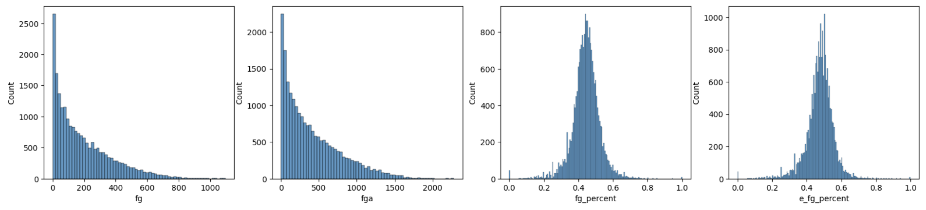
The Data
Over 50 features and 20,000 records dating back to 1979, when the three-point line was first implemented.
Sumitro Datta formatted this data from Basketball-Reference.com in csv files on Kaggle: https://www.kaggle.com/datasets/sumitrodatta/nba-aba-baa-stats

Slide 5
Data Wrangling
Similar Leagues and Rules
1
Only use seasons after 1979
Impute averages when appropriate
2
Attendance at home games, or team win record for players traded mid-season
Drop Irrelevant, Problematic Data
3
Such as players with 0 minutes played
extrêmement froid
Impute Zero when appropriate
4
Such as a three-point percentage for a center who never shot a three-pointer

Slide 6
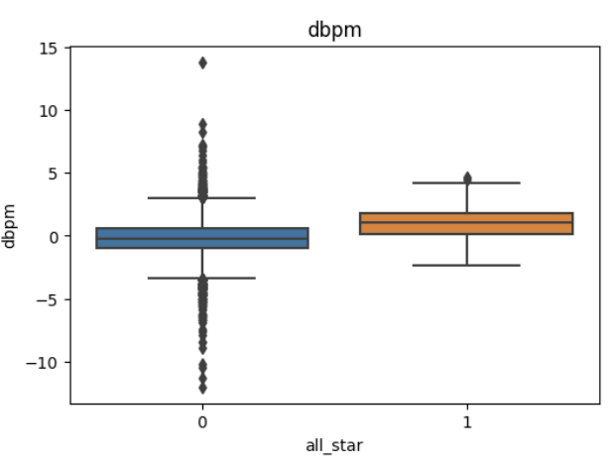
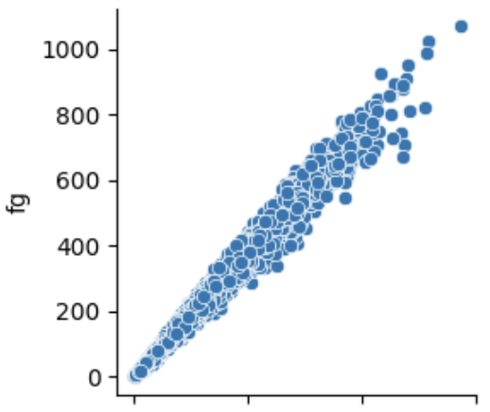
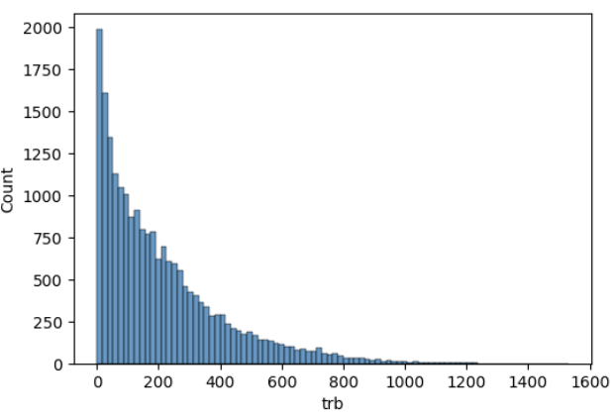
Exploratory Data Analysis
Outliers
Correlations
Skewed Data
Imbalanced Classes
97% of players are not All-Stars

Slide 7
Model Selection
Random Forest Classifier
Logistic Regression
Support Vector Machines
Naive Bayes Classifier
Our Random Forest Classifier had a F1 score of 0.88.

Slide 8
Scaling, Resampling, and Hyperparameter Tuning
Standard Scaler
SMOTE and Tomek Links
Grid and Random Searches
A Random Forest with default parameters with 300 estimators performed the best.

Slide 9
Takeaways and Future Research
The model was more strict (or pessimistic) than 2023 voters
Other Useful Data?
Social media, sponsorships, cumulative player data vs a single season
Are older seasons relevant?
As the game evolves, would the model be improved by favoring recent data?
Changes to selection process
Restrictions around games played, for example.

